Slide 1
Advancements in Incident Management Technology
Louisiana Emergency Management Conference
Lake Charles, LA
Wednesday, May 8, 2024

Slide 2
Overview
Background and Goals
About the Board
Testing and Exercise
Brief Demo
Training

Slide 3
Background and Goals
GOHSEP had been using an often-updated resource request board since 2012.
As the State EOC mission flow changed each year, the board was continually modified to keep up with new branches, positions, and workflows.
These changes accumulated to the point that we begin operating outside of what the board was built to handle.
  COVID logistics processes contributed heavily

Slide 4
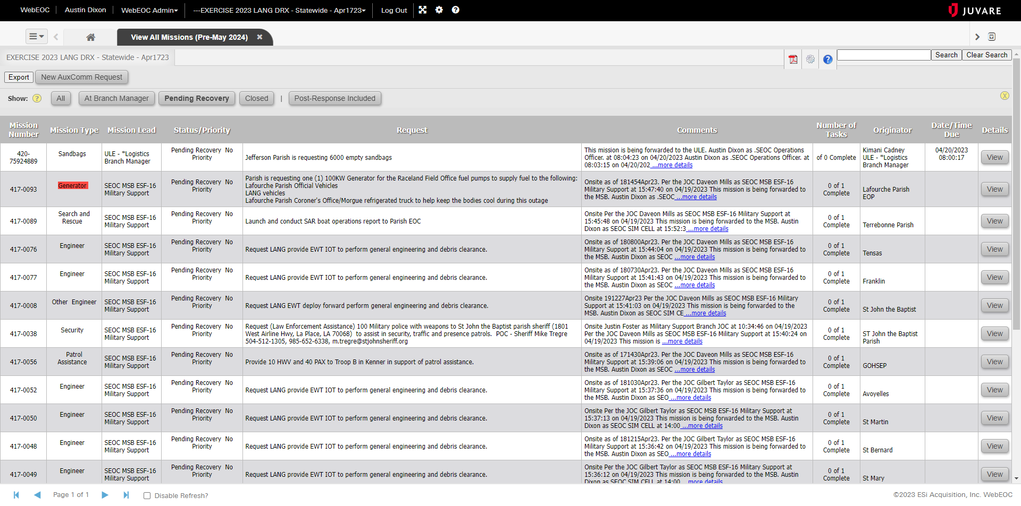

Slide 5
Background and Goals
In 2023, we approached Juvare to build a new resource request board with modern features that we could adapt to our changing mission flow.
We used Juvare’s RID board (Resource, Inventory, and Deployment) as the base for our project.
Worked with Juvare’s development team out of Lithuania to build the major features.

Slide 6
Background and Goals
Should be adaptable to a changing workflow
Track mission time and total duration
Better data management structure
  Mission and task comments and history
Build out a dedicated purchasing section
Track vendor deliveries
Mobile responsive design
Enhanced notification options

Slide 7
About the Board
LA PRIER
  Portal for
  Resource requests
  IMAC
  EMAC and
  RRFs
Prier is French for “request, call upon, pray”
Future additions: IMAC RFP, EMAC API, FEMA RRFs; also can potentially add resource tracking for ESF-07

Slide 8
About the Board
Mission flow is largely the same
Improved data record management (comments/history)
“Save as draft” feature for new requests
Notifications for ESF task assignments as well as contracted vendors
New vendor forms includes proof-of-delivery photo and digital signature
Fully functional in the WebEOC app

Slide 9
Testing and Exercise
Cajun Kaleidoscope
  Processed 358 resource requests
  Created a 34-point improvement plan
  One bug reported: resolved
Published board for real-world events on May 5, 2024.
UMR Training Exercise scheduled
GOHSEP Finance Training Exercise scheduled

Slide 10
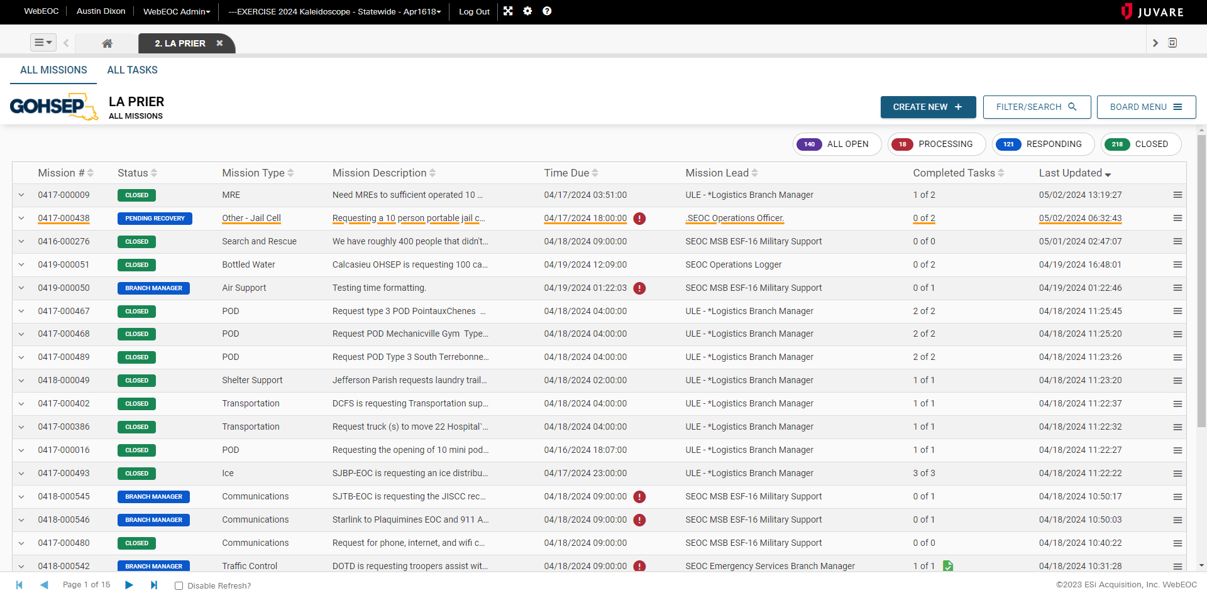

Slide 11
LA PRIER (2024)
MISSION/TASK (2012)

Slide 12
Brief Demo

Slide 13
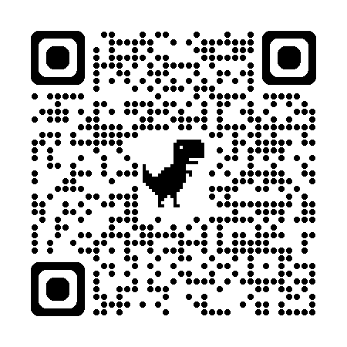
Training
WebEOC-400
  Special Topics in WebEOC
  LA PRIER (2024)
Two offerings available
  Tuesday, May 14
  Wednesday, May 15
WebEOC-100 and WebEOC-200
  Late May
REGISTER FOR WebEOC-400

Slide 14

Contact Info
Austin Dixon, PWA
  Louisiana GOHSEP
  E-Mail: Austin.Dixon@la.gov
  Phone: (225) 922-2190
WebEOC SUPPORT

